Slide 1

Speech to Text Model (STT)

Slide 2
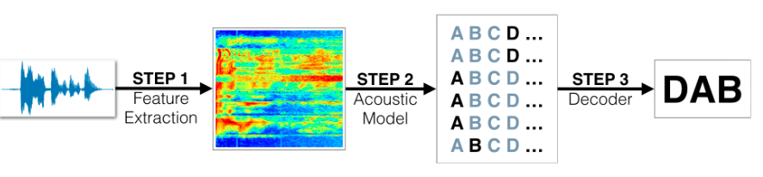

Slide 3
http://www.openslr.org/12/
LibriSpeech ASR corpus

Slide 4
Contents
Input
Model
Architecture
Output

Slide 5
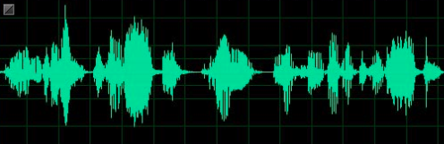
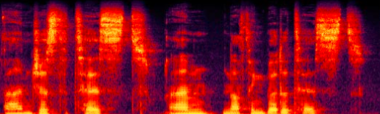
Input (Speech)
The Input Speech wave is sampled and Fourier Transformed to get the Spectrogram, which is the input for the Deep Learning Model.
Fourier Transform

Slide 6
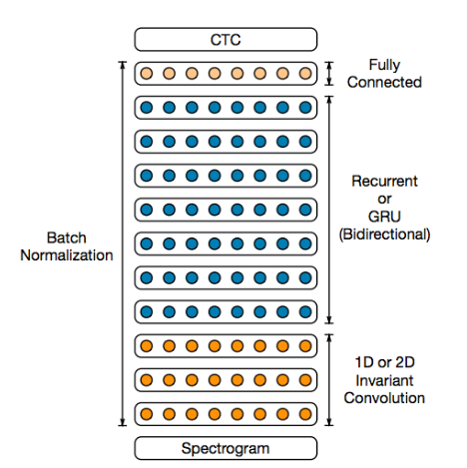
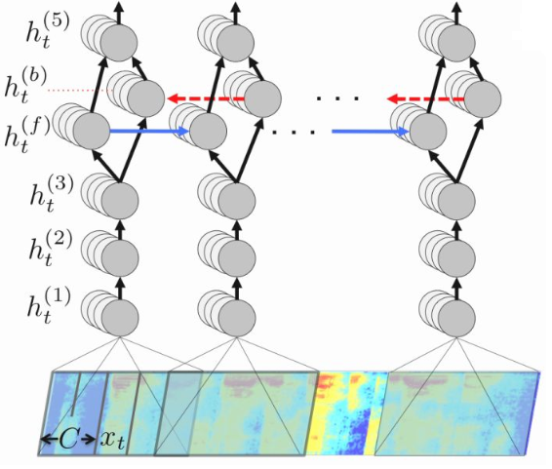
Speech To Text (STT) Model

Slide 7
Speech To Text (STT) Model

Slide 8
STT Model Architecture – RNN Model
Output →
Bi-Directional LSTM (2048 units
per direction) →
Dense Layer (2048 units) Dropout 0.05
Dense Layer (2048 units) Dropout 0.05
26 MFCC features →

Slide 9
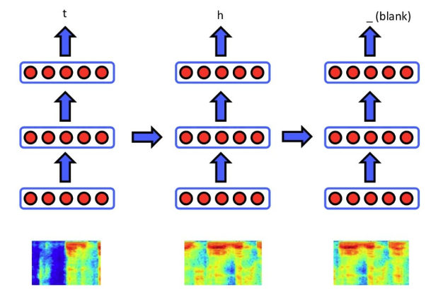
Output of the RNN Model

Slide 10
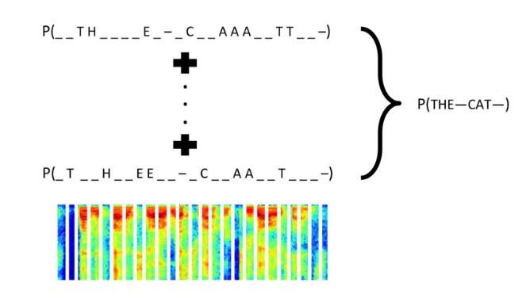
Applying Connectionist Temporal Classification (CTC)

Slide 11
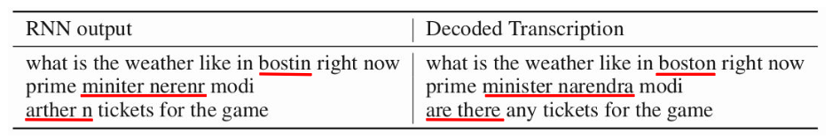
Language Model – N Gram
● Why we have these errors?
Words rarely or never appear in the training sets
● Solution: N-gram language model
Easily trained from huge unlabeled text corpora

Slide 12
References
● https://arxiv.org/pdf/1512.02595v1.pdf

Slide 13
Thankyou

